Slide 1

3

Slide 2
Back to Game
Restart Game
Save Game
Exit Game

Slide 3
3
4
5
1

Slide 4
1
2
3
4
5
6

Slide 5
Choose option to Save
1
2
3
4
5
6

Slide 6
Back to Pause Menu

Slide 7

1
2
3
4
5

Slide 8
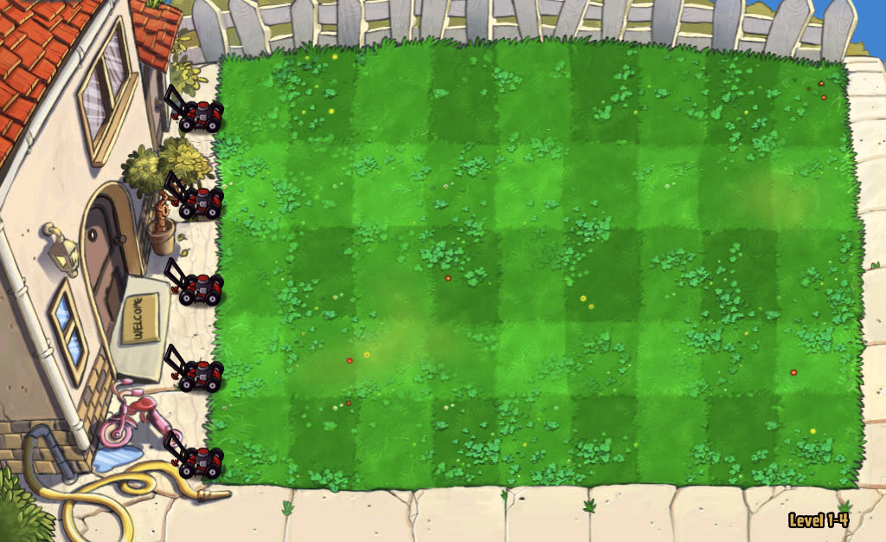
Made by – Himanshu and Udit

Slide 10
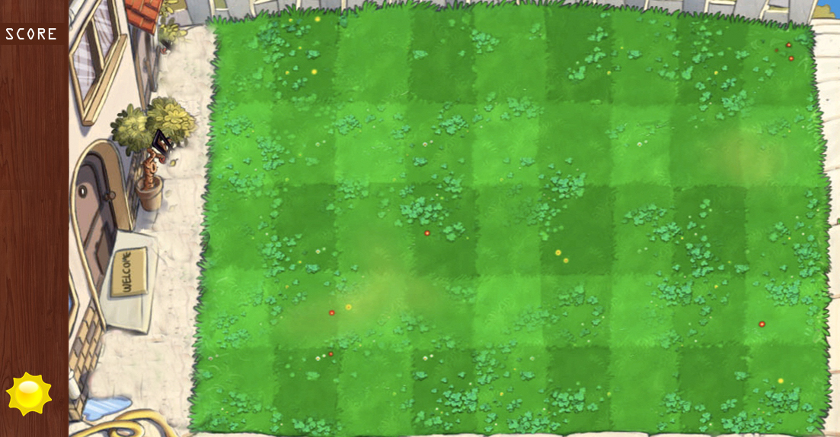

Slide 11
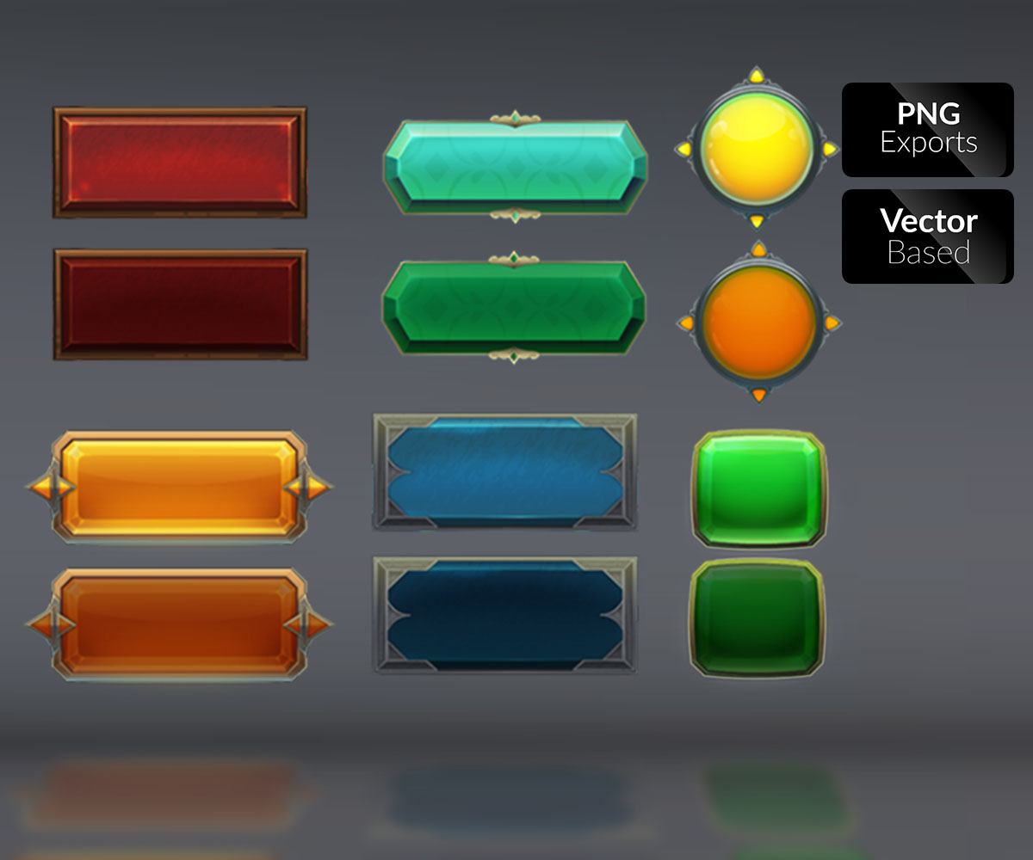
SAVE
RESTART
LOAD GAME
NEW GAME
EXIT

Slide 12
CHOOSE LEVEL

